Slide 1
LEARNWORDS
A VIRTUAL CLASSROOM PLATFORM
GUIDED BY,
MS. ROSE MARY THOMAS
ASHISH S KOSHY
HELAN MARIYAM AIPE
SOJU MATHEW
SWATHISH KRISHNA

Slide 2
OUTLINE OF THE PRESENTATION
INTRODUCTION
EXISTING SYSTEM
DEMERITS OF EXISTING SYSTEM
SCOPE
LITERATURE SURVEY
METHADOLOGY
SYSTEM DESIGN
IMPLEMENTATION
RESULT
MERITS OF PROPOSED SYSTEM
CONCLUSION
REFERENCE

Slide 3
INTRODUCTION
Learnwords is based on powerful scientific visualization techniques and can be used as an effective aid in online virtual teaching.
The project deals with creation of a virtual classroom website which mainly focuses on the interaction of teacher-student relationship.
Comparing existing virtual platforms, this mainly rely on voice supporting facility and also helps in attaching and viewing documents.

Slide 4
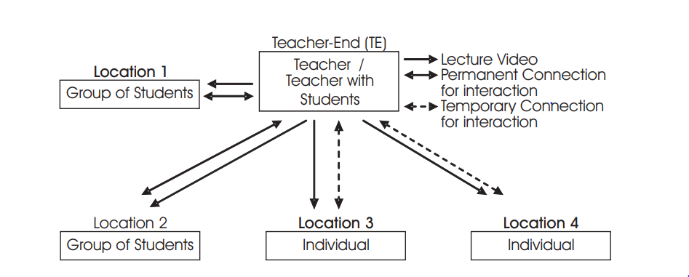
LAYOUT OF VIRTUAL LEARNING

Slide 5
EXISTING SYSTEM
Virtual classrooms today are used by educators to replicate a customary practice carried out for centuries, i.e. to teach exactly as they did in a typical classroom.
The main goal was to succeed to offer students an experience similar to a face-to-face classroom.
In many cases this wasn’t succeeded, due to network and equipment limitations that lead into sound and video problems, as well as due to lack of suitable tools.
Most of the present systems provide video supporting facilities rather than voice supporting.

Slide 6
DEMERITS OF EXISTING SYSTEM
If a student needs to clarify a simple doubt, the teacher needs to upload a video rather than a single voice.
On other hand, if the teacher has uploaded a high quality video and the student is unable to download it due to any technical issues, it can be considered as one of the demerit.
The question raised by the student can be missed by the teacher while scrolling.

Slide 7
SCOPE
In this project, we are solving some of the problems which has been noted. It includes:
The voice-supporting facility for the faculty
The answered and unanswered section separately for easy identification.
This project has a lot of scope for future development. Other than above mentioned, features like attach document files as well as video presentations and many more such functionalities can be implemented in the later versions of the software.

Slide 8
LITERATURE SURVEY The Influence of Virtual Education on Classroom Culture
Kathleen A. Greenan, introduced a journal The Influence of Virtual Education on Classroom Culture[1] where she depicted the vital role of virtual classroom, a traditional class environment relies on verbal and nonverbal communication to create and foster cultural norms, behaviors, practices, and beliefs. It is important to develop social presence in virtual education courses through:
1) synchronous teaching and learning,
2) self-disclosure for fostering student engagement, creating relationships, and building supportive class communities.

Slide 9
DIGITAL EDUCATIONAL SYSTEM IN BANGLADESH
Faieza Chowdhury[2] researched on how to create a digital Educational System in Bangladesh and concluded that the use of web-based tools for educational purposes is a rapidly growing trend in Bangladesh.
This paper addresses students’ opinions on the use of virtual classroom from their own personal experiences and identifies features of virtual classroom that are vital to create an interactive student-centered learning environment.

Slide 10
FIRST INTERNATIONAL CONFERENCE ON FUTURE GENERATION COMMUNICATION TECHNOLOGIES
It connects the advantage of existing offline approaches like a white board with advantages of life streaming systems with many participants.
The model of this basic virtual classroom is basis up on 4 main technologies itself. They are:
The flash media server architecture
The RTMP protocol
The client server connection flows &
The shared objects.

Slide 11
METHADOLOGY
Learnwords can be used and implemented by the respective students who has a username and password, stored in database.
After logging in, the student can access the facilities provided by the faculty.
The student can view the document files, hear the attached voice clippings of the respective faculty.

Slide 12
If it’s a faculty, he or she can login and attach documents, voice clippings of their respective subject.
This mainly focus on virtual teaching along with question and answer session.
Student can ask questions and the answer can be uploaded by the respective faculty.
The answered and unanswered section is separated for easy identification.

Slide 13
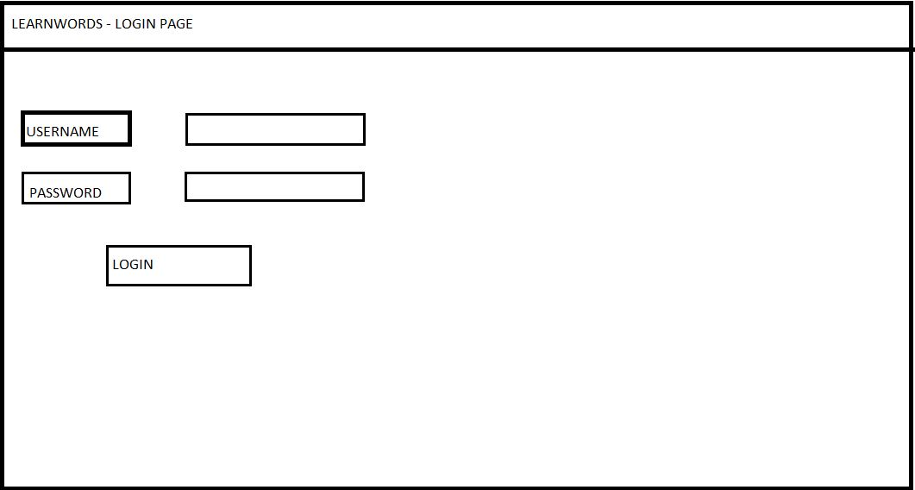
SYSTEM DESIGN
LOGIN PAGE

Slide 14
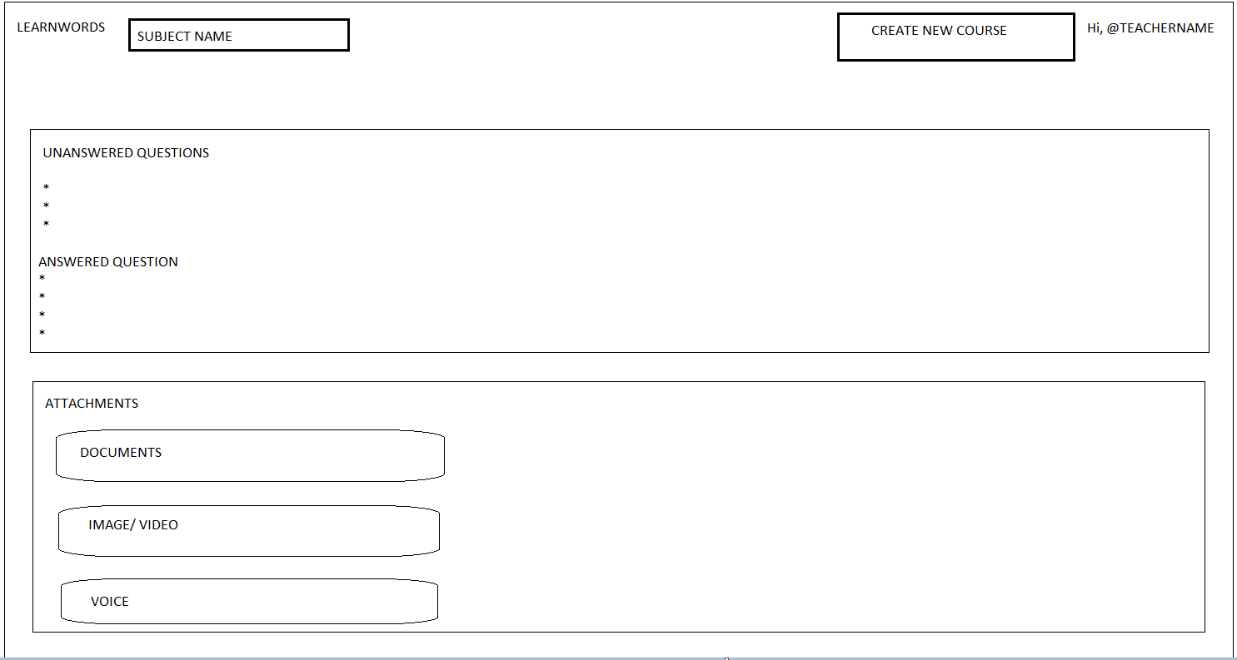
COURSE PAGE
Only visible to faculty

Slide 15
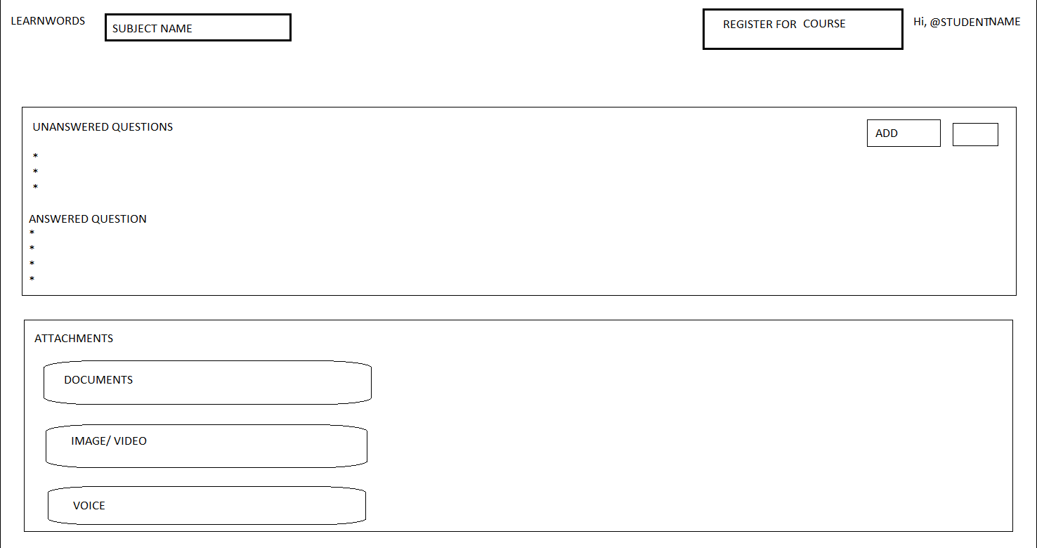
STUDENT PAGE

Slide 16
IMPLEMENTATION
For implementing, we uses languages JAVASCRIPT, HTML/CSS, and MYSQL as database.
We create a login page for logging of both student and the faculty.
They can login using username and password.
If it’s a student, then he or she can join for the course using the course code.
After joining the course, he or she can view the respective attachments, can ask questions and can view the answered questions.

Slide 17
The attachments can be document, voice clipping or image or video clip and can be reached using the link provided.
If a faculty login, he or she can create the new course for the students.
After creating a course, she can add attachments (either document, voice clip, video or image) using the menu provided.
He or she can answer the questions asked by the student.
The answered and unanswered question can be displayed separately.

Slide 18
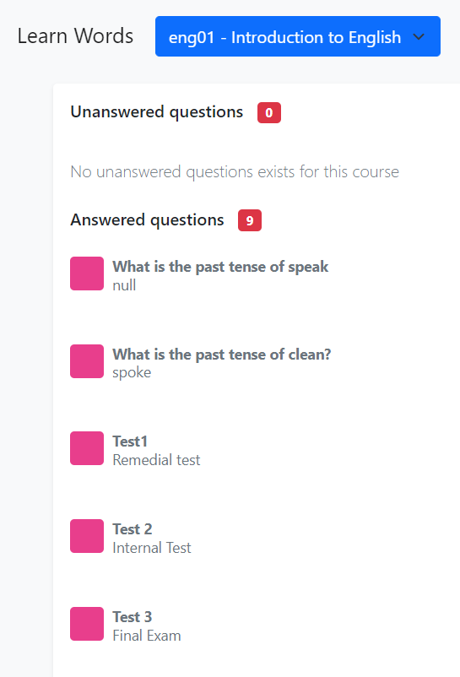
RESULT
The proposed system is developed with the facilities of attaching voice clips.
Moreover the separate session for answered and unanswered questions can also be displayed.
When the teacher has added a new course INTRODUCTION TO ENGLISH and has added attachments and had responded to the questions asked by the student can be shown below.

Slide 19
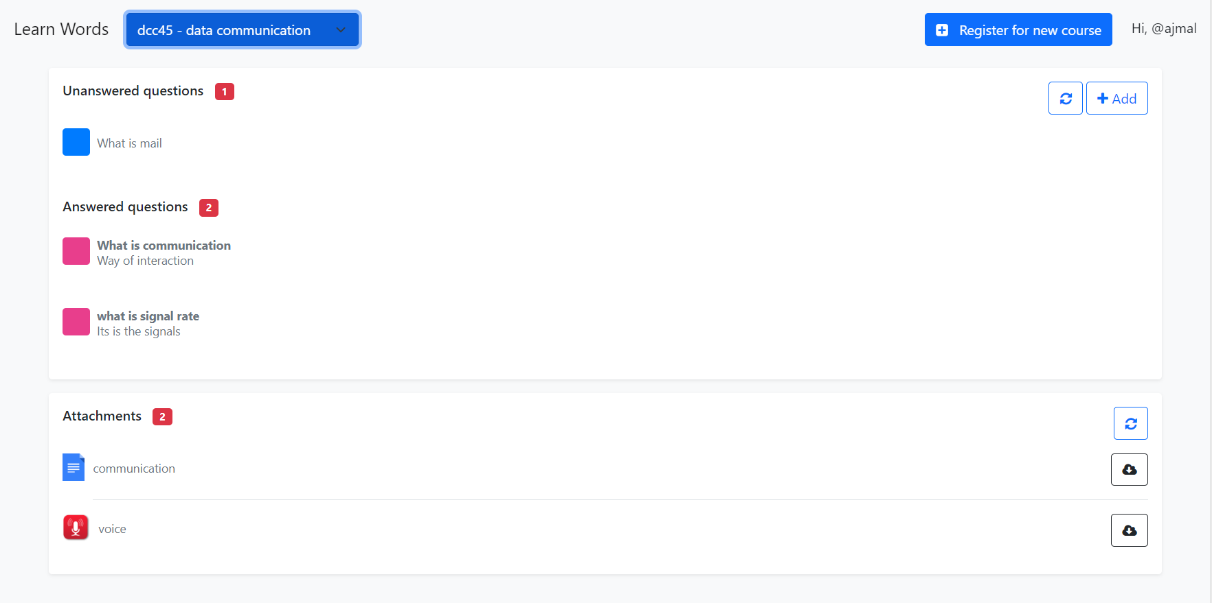
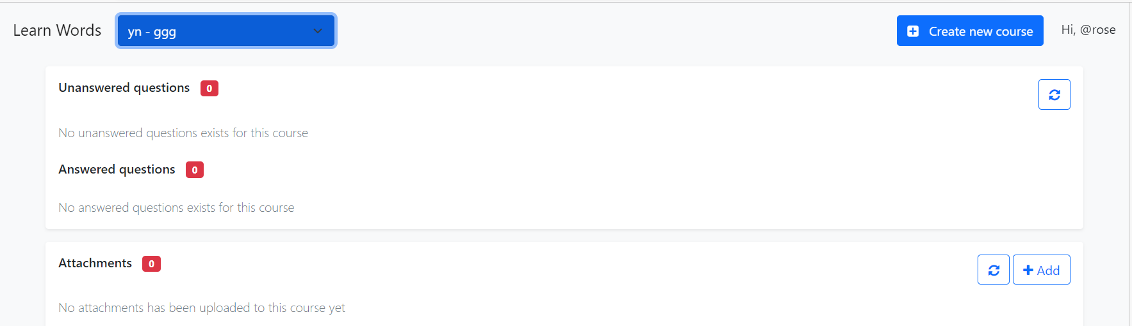

Slide 20
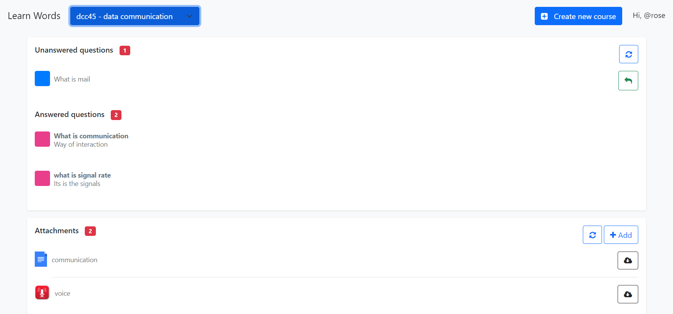

Slide 21
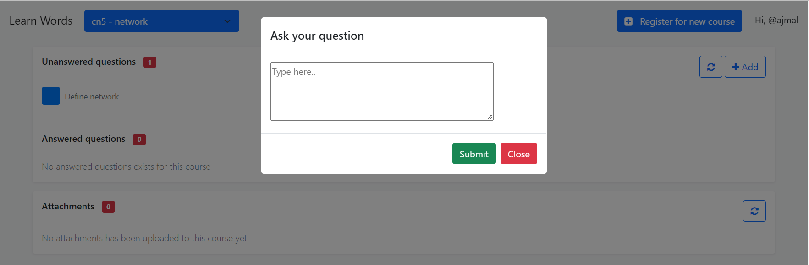
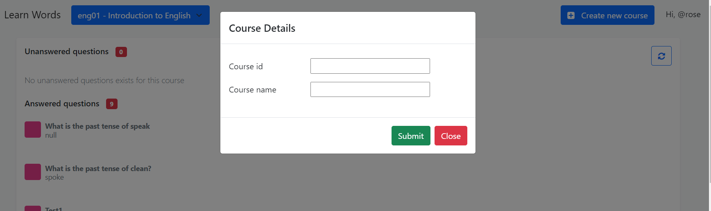

Slide 22
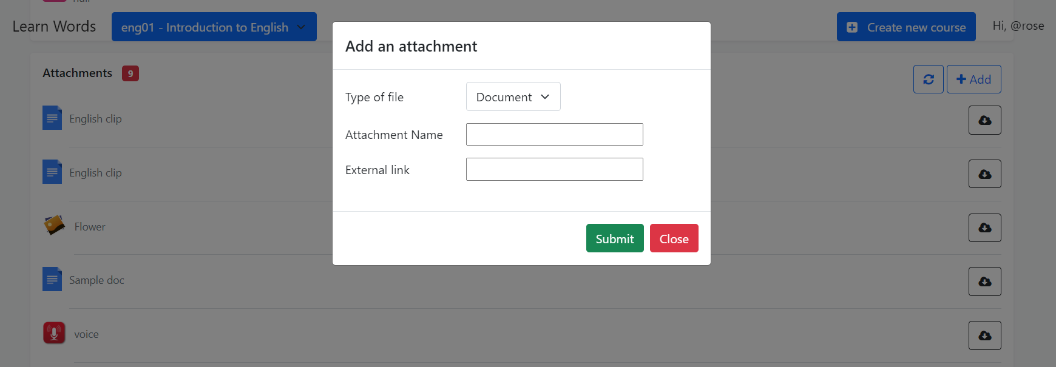

Slide 23
MERITS OF PROPOSED SYSTEM
The merits of this proposed system includes:
i. Voice attaching facility
ii. Question and answer section
iii. Separate answered and unanswered section

Slide 24
CONCLUSION
Virtual education is an emerging concept.
Here the classes are not taken face-to-face in a classroom but through an electronic medium as a substitute.
Taking up these virtual classes through an electronic medium is termed as E-Learning.
E-Learning is proving itself as a boon for students especially for the disabled who are not able to go and attend the lectures.
Our work, LEARNWORDS provide a best student-teacher interaction for learning.

Slide 25
REFERENCES
[1]Frontiers | The Influence of Virtual Education on Classroom Culture (frontiersin.org)
[2] (PDF) The effects of “live virtual classroom” on students’ achievement and students’ opinions about “live virtual classroom” at distance education (researchgate.net)
https://fdocuments.in/document/srs-for-virtual-eucation.html
http://en.wikipedia.org/wiki/History_of_virtual_learning_environments/
https://www.slideshare.net/susheel2658/srs-for-virtual-eucation

Slide 26
THANK YOU….!

